Slide 1
Brainhack tIL 2021:
Team delta
Team members:
Nguyen Cao Duy
Tran Xuan An
Tan Song Ze
Lance Nathan Beltran Mosura
Bryan Chua Bing Huan

Slide 2
Presentation OUtline
Introduction
Audio classification
Challenge 2, 4, 6
Challenge recap & Overview of frameworks
Object detection
Conclusion & QA
Challenge 1, 3, 5

Slide 3
Challenge recap

Slide 4
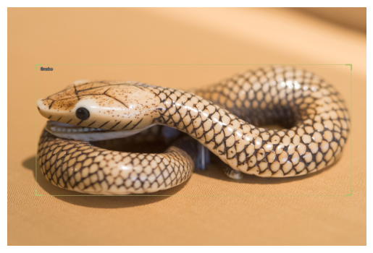
Object detection
Create bounding boxes around the animals in the photo
Classify the detected animals into different classes such as ‘Snake’, ‘Dog’, etc.

Slide 5

Audio Classification
Classify the sound files into difference single word commands such as ‘One’, ‘Forward’, ‘Snake’, etc.

Slide 6
Framework Overview

Slide 7

fastai
A deep learning library built on top of PyTorch which provides high-level components that can quickly and easily provide state-of-the-art results.

Slide 8

icevision
An agnostic fastai-like framework specific for computer vision

Slide 9

fastaudio
An extension of fastai for audio-related tasks

Slide 10
Object detection

Slide 11
pipeline
Data preparation
Model training
External data
YOLOv5
Data preprocessing
Prediction
Resize (384) & Data augmentation
Restore bounding boxes

Slide 12
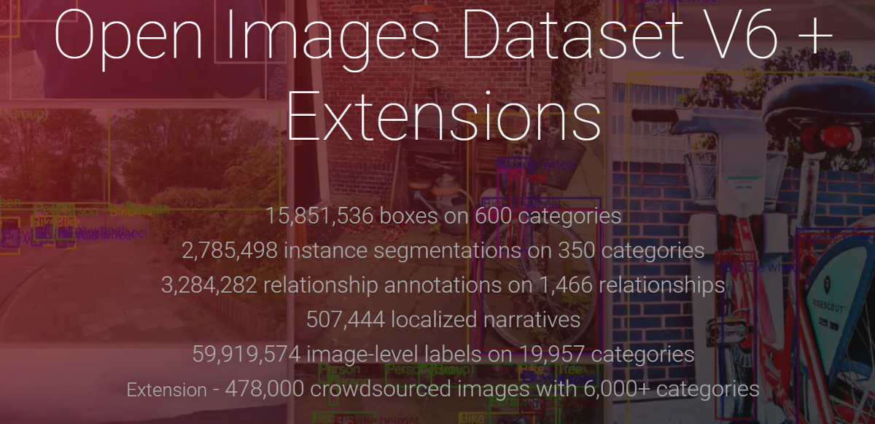
External data
Increase the original dataset by 10-20 times!

Slide 13
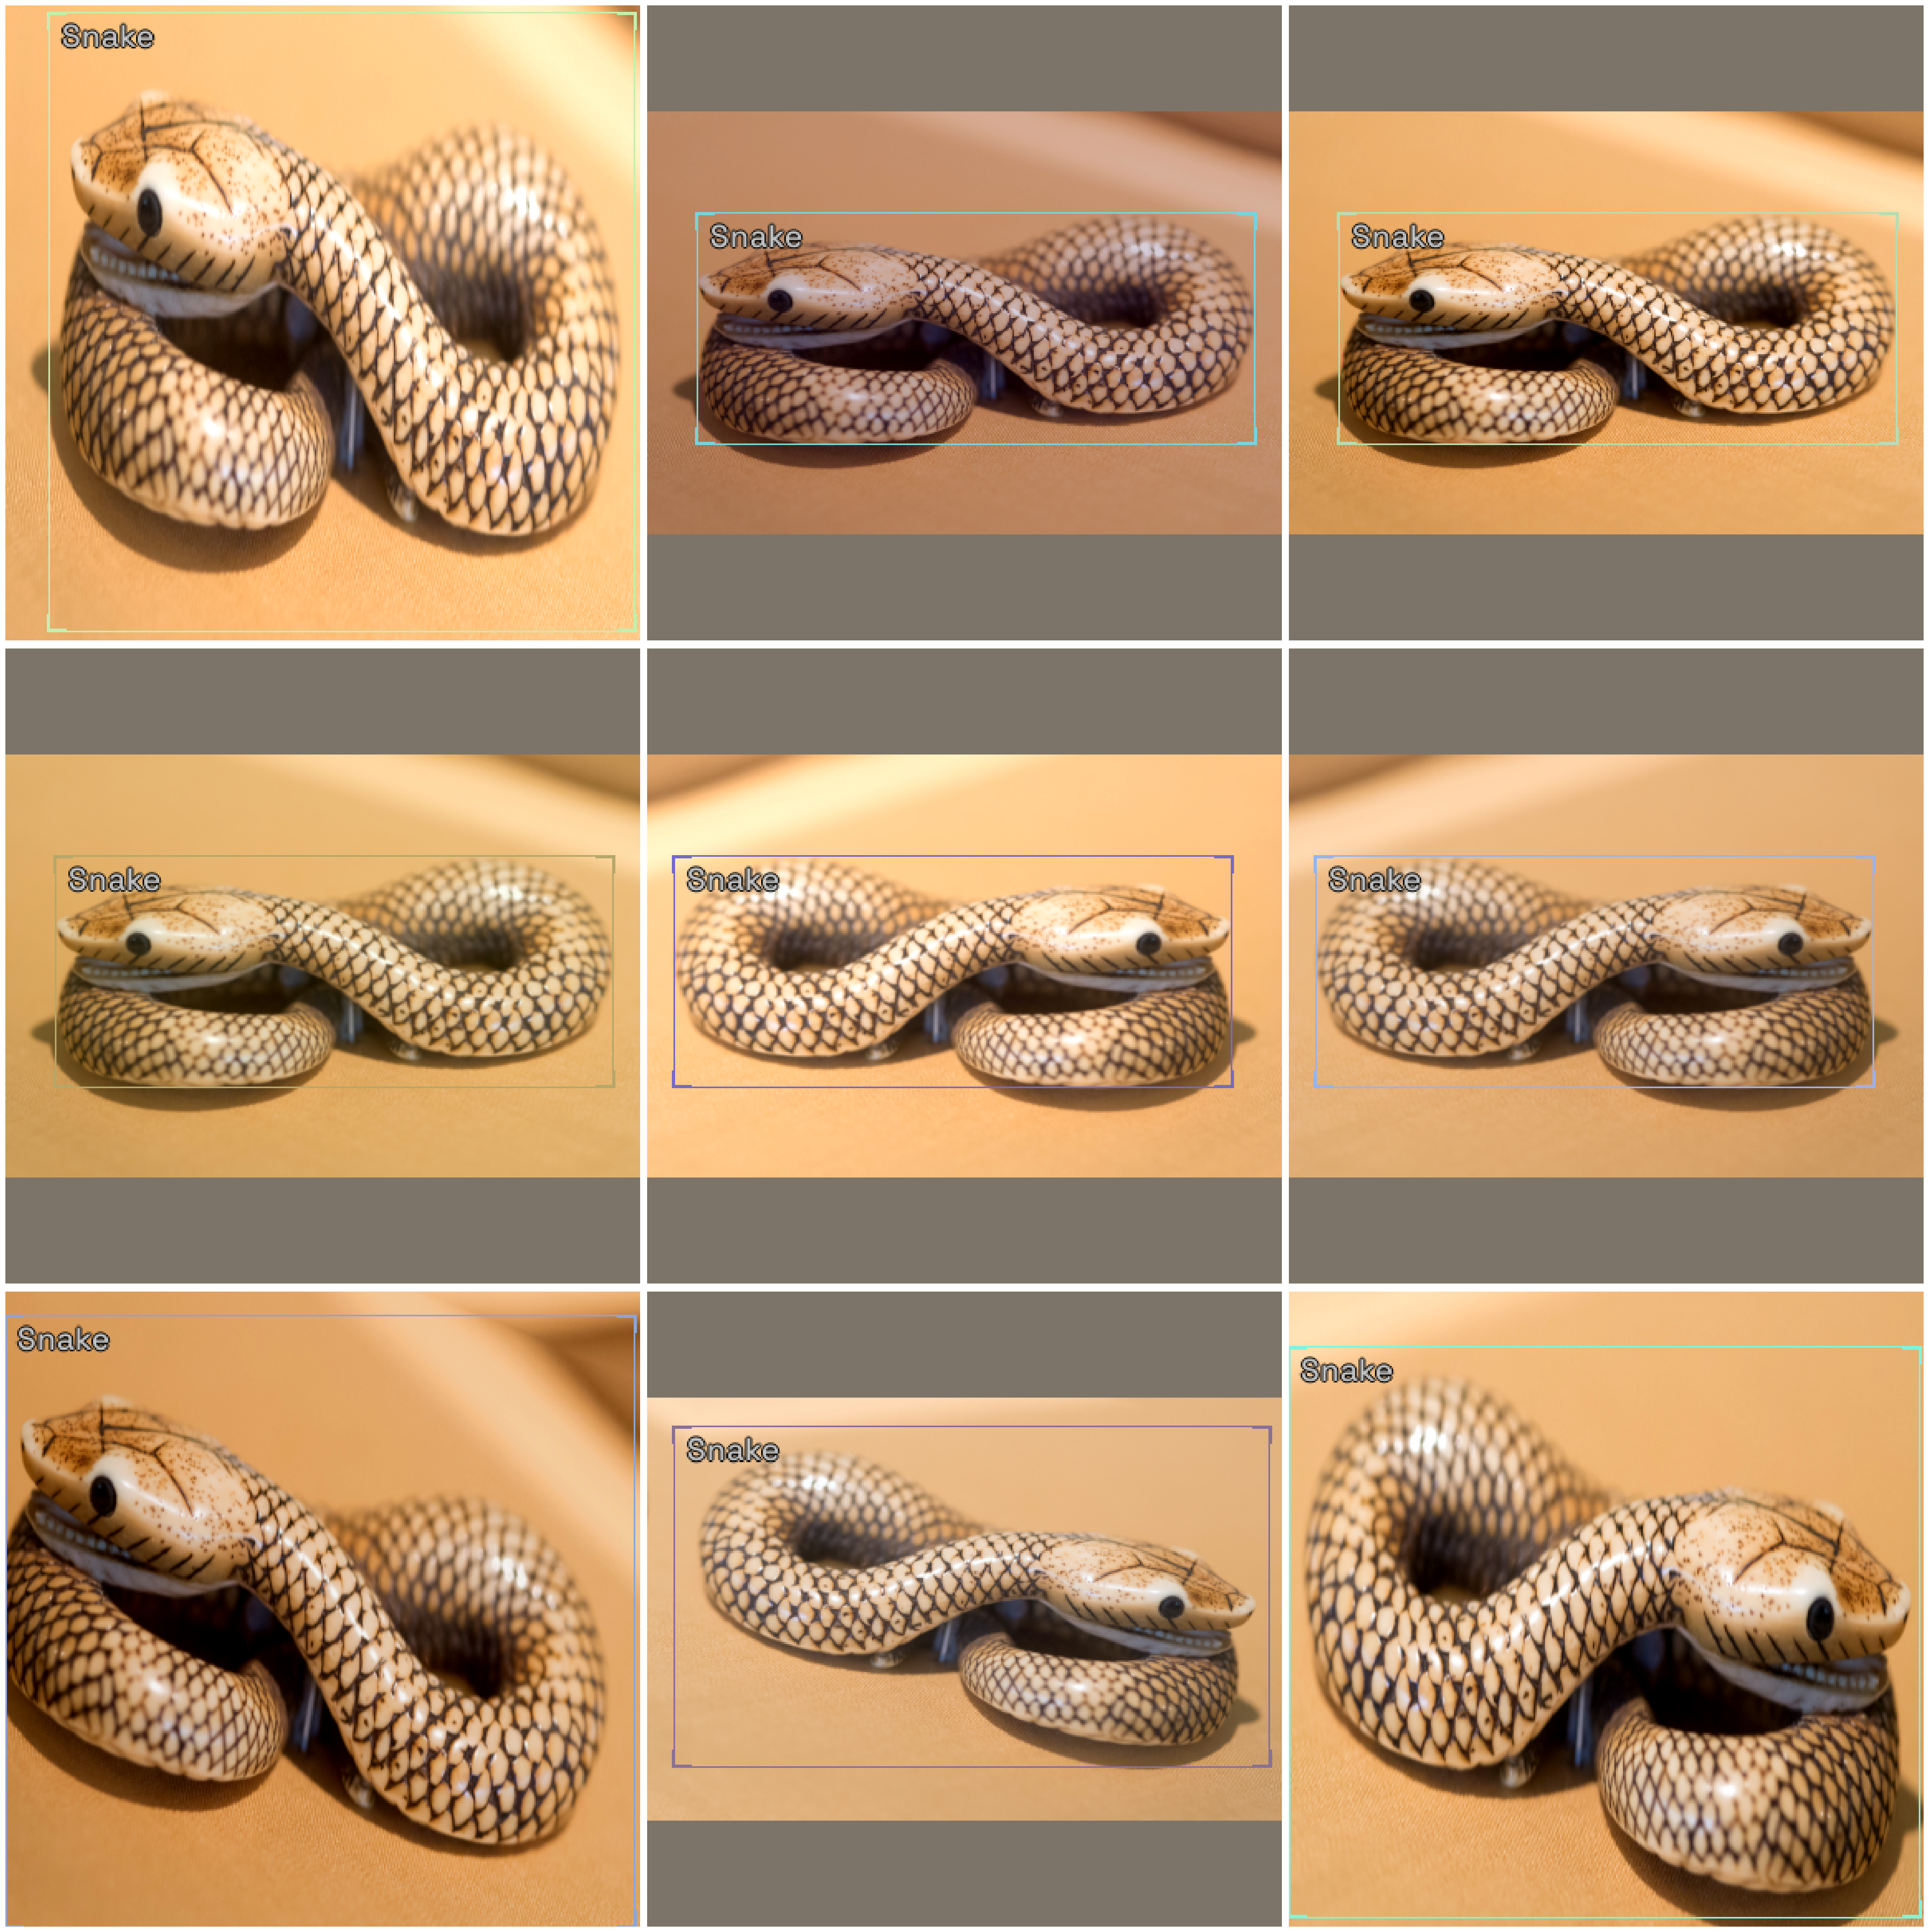
data augmentation
HorizontalFlip
ShiftScaleRotate
RGBShift
RandomBrightnessContrast
Blur

Slide 14

Model training
Different pretrained models were considered: RetinaNet, Faster R-CNN, EfficientDet
Chosen model: YOLOv5 (extra-large)
Best training/testing time & mAP
Pretrained on the COCO dataset (from `ultralytics`)

Slide 15
Model training
Optimizer: Adam
Loss function: BCEWithLogitsLoss (class probability and object score)
Focal Loss was also considered to address the imbalanced dataset
2-stage training:
1) Freeze the model body, train the model head for a few epochs
2) Unfreeze the model body, then train the entire model for at least 30 epochs
Mixed precision training was used to reduce memory usage (explained later)
Learning rate finder was used to find the most optimal learning rate (explained later)
1cycle training policy was also used (explained later)
Save model callback is used to log the model with the best validation loss

Slide 16
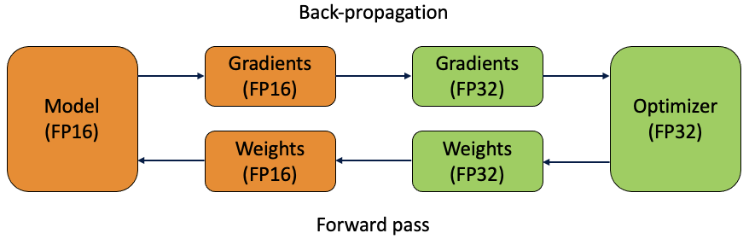
Mixed precision training
Main idea: forward pass and gradient computation in half precision fp16 (to go fast), but backpropagation in single precision fp32 (to maintain precision)
Benefits:
1) Only 1 line of code change with `fastai` training loop
2) Allows us to increase our batch size, thus reducing training time

Slide 17
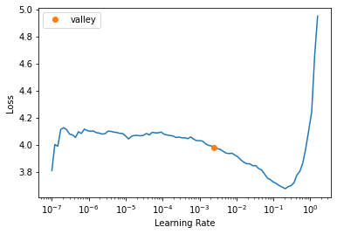
Learning rate finder
Main idea: launch a mock training on a few batches of date while varying the learning rate and plot the correspondence training loss
Benefit: systematically determine the optimal learning rate without guessing

Slide 18
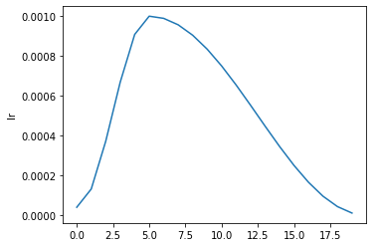
1cycle training policy
Main idea: increasing learning rate at the beginning, then decreasing learning rate
Benefit: faster convergence

Slide 19
Audio classification

Slide 20
pipeline
Data preparation
Model training
External data
ResNet, DenseNet, etc.
Data preprocessing
Prediction
Mel spectrogram (1000ms) & Data augmentation
Test time augmentaion & Ensemble

Slide 21
External data
Two additional datasets: Free Spoken Digit Dataset (FSDD), Speech Commands
Increase the original dataset by 5-10 times!

Slide 22
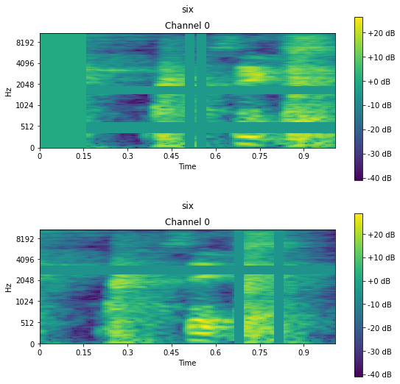
data augmentation
MaskTime
MaskFreq
SignalShifter
ChangeVolume
SignalCutout

Slide 23
Model training
5 different models were chosen
3 were pretrained on ImageNet: ResNet, DenseNet, VGG
2 were trained from scratch: XResNeXt, XSE_ResNet
=> To have different diverse models for ensembling
Optimizer: Ranger (explained later)
Loss function: CrossEntropyLoss
1-stage training:
Unfreeze the model body, then train the entire model for at least 15 epochs
Similar task-independent technique were also used: mixed precision training, learning rate finder, 1cycle training policy, save model callback

Slide 24
Ranger optimizer
Main idea: a combination of Rectified Adam (RAdam) with Lookahead optimizer
RAdam is an improved version of Adam regarding the adaptive momentum mechanism
“On the Variance of the Adaptive Learning Rate and Beyond”
Lookahead is a safety mechanism to reduce variance in training
“Lookahead Optimizer: k steps forward, 1step back”
Benefit: better convergence compared to Adam (especially when training models from scratch)

Slide 25
Test time augmentation (tta)
Random augmentation transforms are applied on each image before prediction
Repeat this process for n times
Calculate the average prediction probabilities

Slide 26
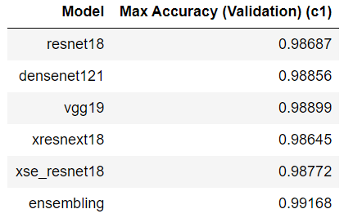
Model ensembling
Main idea: average the predictions of all 5 models after TTA (n = 5)
The final prediction for each image is a combination of 25 different predictions!

Slide 27
Thank you for attention

Slide 28
Q & A
We would love to answer your questions!

